Slide 1
Weather and Climate: Earth’s Atmosphere
Notes:
1

Slide 2
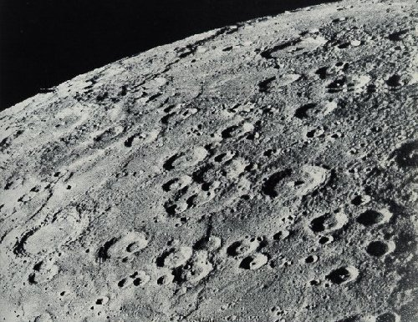
Why are their surfaces different?

Slide 3
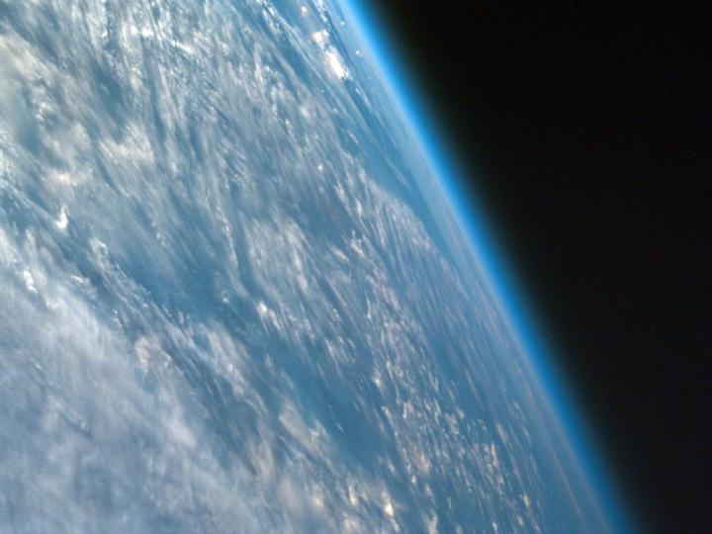

Slide 4
Weather and Atmosphere
Weather is the condition of Earth’s atmosphere at a particular time and place. Weather and temperature around the globe are affected by gases and moisture (______ vapor) in the Earth’s atmosphere.
Earth’s atmosphere is the envelope of gases that surrounds the planet. The atmosphere is composed of a mixture of atoms and molecules. By trapping some of the ____________, the atmosphere keeps the Earth at a temperature in which life can exist.

Slide 5
Composition of Earth’s atmosphere
Gases in atmosphere are usually expressed as a percentage of “dry air” because air contains varying amounts of water vapor.
Gases are retained in Earth’s atmosphere by gravity.
The atmosphere is made up of:
1. Nitrogen
a. most abundant gas (78%)
b. found as diatomic molecules

Slide 6
2. Oxygen
A. Second most abundant gas (21%)
B. Oxygen is vital for living organisms as well as the burning of fuels such as fire and gasoline in cars.
C. Most are found as diatomic molecules. Ozone (O₃) has three atoms of oxygen and it forms when lightning interacts with the oxygen in the air.
Ozone also has the important role of filtering out harmful ultraviolet (UV) rays in the upper atmosphere.

Slide 7
Atmosphere Comp. Continued
3. Trace gases
a. the remaining 1% consists of Ar (0.9340%), CO₂ (0.038%) and small amounts of other gases.
b. Carbon dioxide is absorbed by plants to produce food, and released by the burning of fuels and coal. As a result CO₂ accumulates in the atmosphere.
4. Water Vapor
a. water vapor is invisible. It is water in the form of a gas and it plays an important role in regulating Earth’s weather.
b. air has a varying amount of water vapor (1% on average)
c. it produces clouds and precipitation.
5. Solid and Liquid Particles
a. air contains particles of dust, smoke, salt, and other chemicals.

Slide 8
Importance of the Atmosphere
Earth’s atmosphere makes conditions on Earth suitable for living things.
a. It contains gases that all living things need
b. It traps energy from the sun that keeps the temperature warm and water in liquid form. It also reduces temperature extremes between day and night.
c. It protects Earth from UV radiation (_______ layer)
d. Burns up most meteors that come within Earth’s atmosphere.

