Slide 1
Ohm’s Law and Power
Voltage, Resistance, and Current

Slide 2
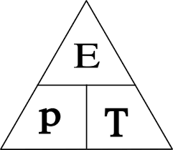
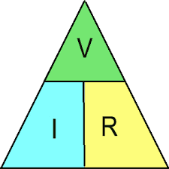
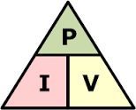
Ohm’s Law
Power Equation
Electrical Energy
V = I x R
I =
R =
P = I x V
I =
V =
E = P x T
P =
T =

Slide 3
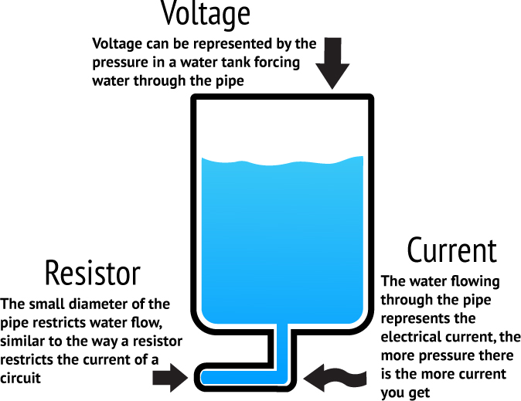
Procedure

Slide 4
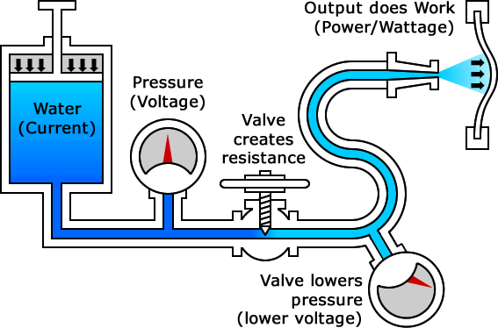

Slide 5
Voltage (V or E)
Amount of pressure causing flow of electrons
Symbol is V or E
Measured in Units of volts
Also called potential difference because it describes difference in charge from one place to another

Slide 6
Current (I)
Measure of electrons per unit time
Symbol is I
Measured in Units of amperes (amps)
One ampere is one coulomb of charge passing a point in one second
One coulomb equals 6.24 × 10¹⁸ electrons

Slide 7
Resistance (R)
Opposition to current flow
Symbol is R
Measured in Units of ohms (Ω)
Current flow limited and voltage divided by resistors
Resistant materials are insulators
Inversely proportional to current

Slide 8
Power (P)
The rate at which work is done or amount of work done based on period of time
Electrical power is product of voltage and current
Measured in watts
One watt is one volt moving one coulomb of electricity in one second

