Slide 1
The Gas Laws

Slide 2
How are Gases Measured?
1. Volume: The volume of a gas is the same as the volume of the container. Units of mL, and L.
2. Temperature: the measure of the average energy of random motion of the particles.
→ faster motion of particles = greater energy/higher temp
3. Pressure: the measure of the force of the outward push of a gas on the walls of the container.
→ gas particles constantly collide with each other and with the walls of the container. This creates pressure.
Notes:
‹#›

Slide 3
The Gas Laws: Pressure and Volume
1. Boyle’s Law: In the 1600’s Robert Boyle found that when he increased a gas’s pressure at constant temperature, the volume of the gas decreased. When the pressure decreased, the volume of a gas increased.
This relationship is called an inverse or indirect relationship. Gas pressure varies inversely with the volume.
Example: Bicycle pump: when you push on the pump (decreasing the volume) the pressure inside increases, forcing air into an object.

Slide 4
Temperature and Volume
2. Charles’s Law: In the late 1700’s Jacques Charles discovered that when the temperature of a gas increased at constant pressure, the volume of the gas increased.
Example: When a balloon filled with helium is lowered into liquid nitrogen (-200° C) it will shrink. in temp. leads to in volume.

Slide 5
Pressure and Temperature
3. 3rd Gas Law: The higher the temperature of a gas, the faster its particles are moving, and the greater the number of collisions. So when the temperature of a gas increases at constant volime, the pressure of the gas increases.
Example: On long trips, the tires on an 18-wheeler truck can get hot due to friction. This increase in temp. causes an increase of pressure inside the tire (volume is constant). If pressure gets too high, the tires can burst, so the drivers must constantly monitor and adjust tire pressure.

Slide 6
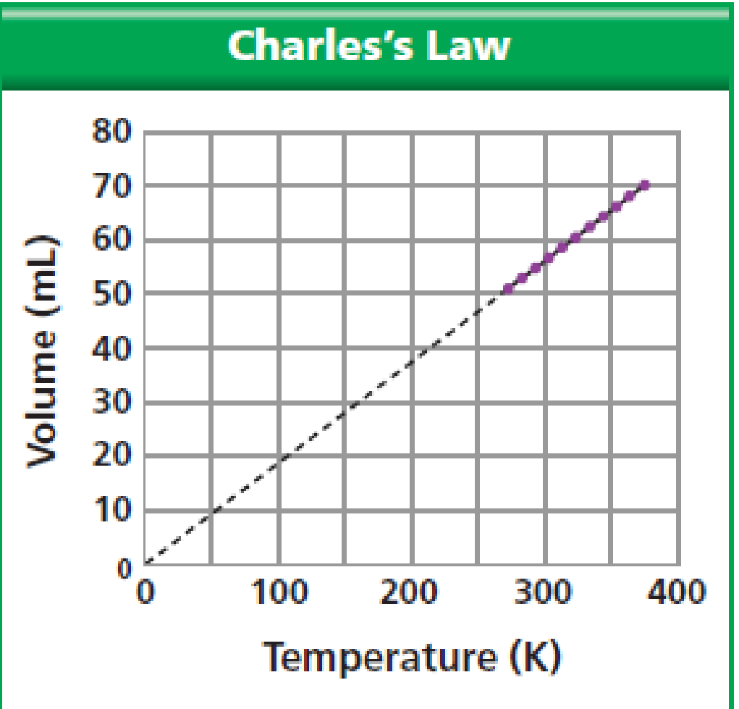
Graphing the Gas Laws
question: What kind of relationship is shown in this graph?
answer:
A direct relationship.

Slide 7
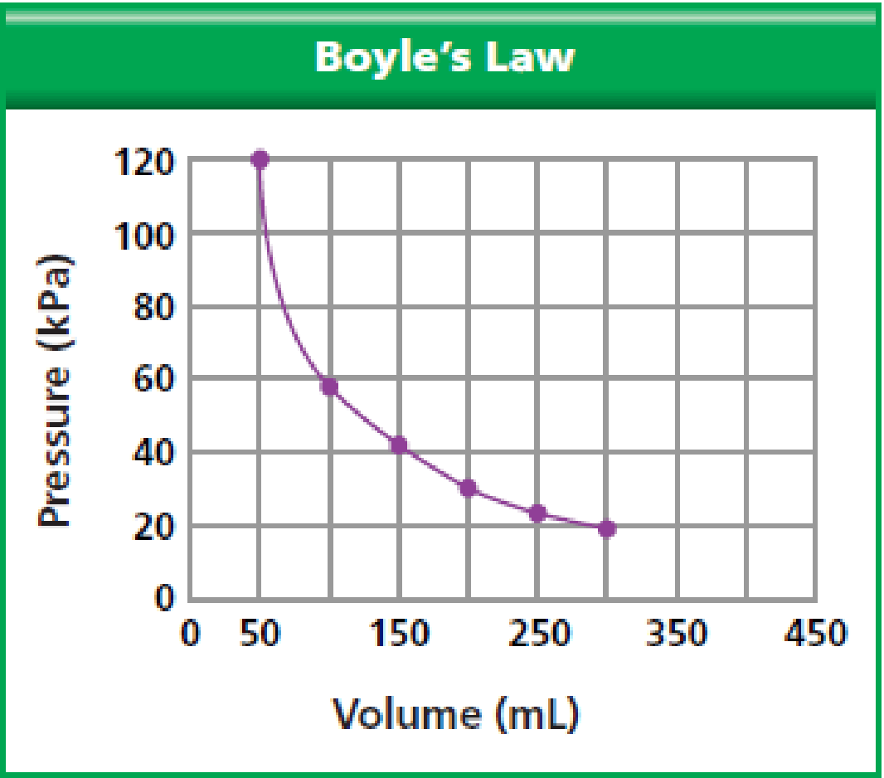
question: What kind of relationship is shown in this graph?
answer:
An indirect relationship.

Slide 8
Experiment with Gases
http://www.mhhe.com/physsci/chemistry/essentialchemistry/flash/gasesv6.swf

